Slide 1
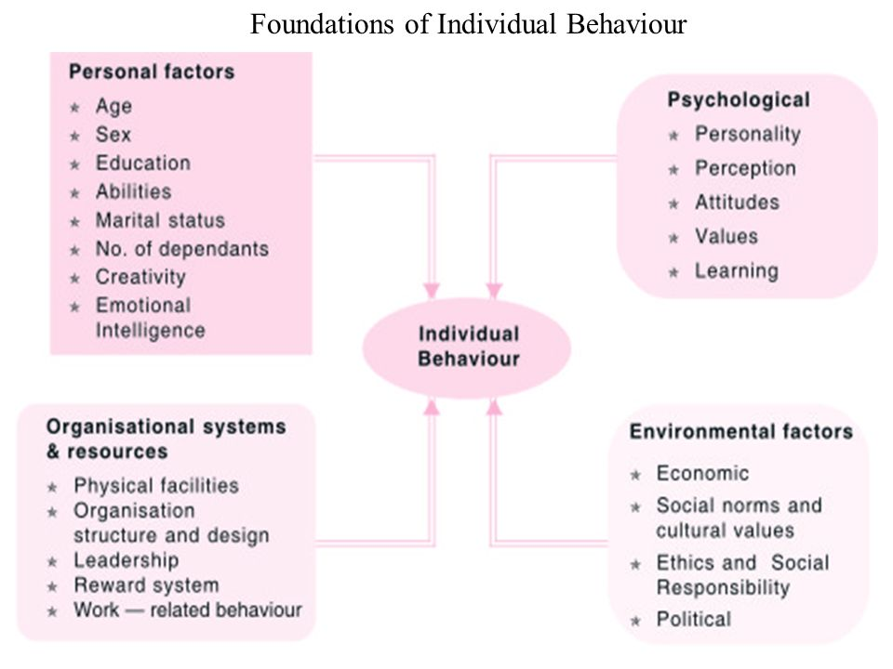
Module2-Foundations of Individual Behaviour

Slide 2
Personal Factors
1)Age🡪 performance
Turnover
Absenteeism
Productivity
Satisfaction
Adaptability
2)Sex-male/female emp-
3)Education-increased levels of education—increase an individual’s expectation received.

Slide 3
4)Intellectual abilities: IQ tests
Dimensions of Intellectual ability
-number aptitude
- verbal comprehension
-perceptual speed
- Inductive reasoning
- Deductive reasoning
-Spatial visualization
-Memory

Slide 4
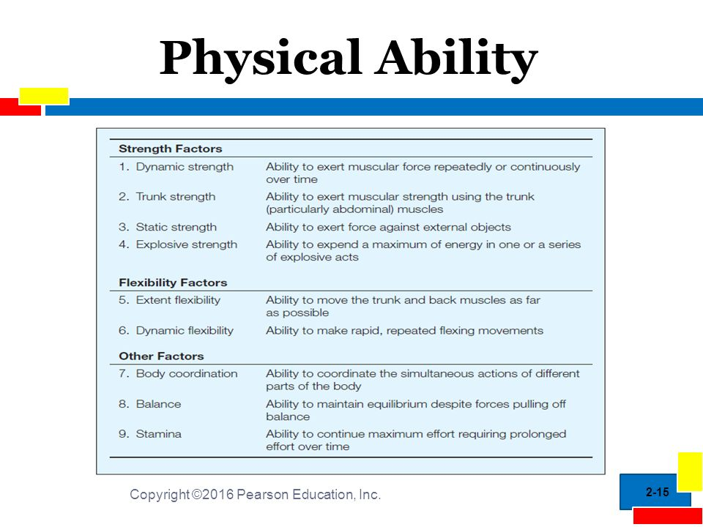
5)Physical abilities:
Manifest in one’s stamina, manual dexterity , leg strength
Mgmt must identify an employee’s physical abilities if these are the major inputs required to perform a task.
9 basic physical abilities

Slide 5
6)Marital Status:
Influence on absenteeism, turnover and satisfaction
Married emp have fewer absences, undergo less turnover and are more satisfied with their jobs than the unmarried ones.
Marriage imposes additional responsibility .
Hence the need for a steady job and steady income.
7)Number of dependants:
There is correlation between the number of dependants an emp has and his or her absences and satisfaction.
The no of children an emp is related to absence, especially in females
8)Creativity
Refers to the cognitive activity that results in a few or novel way of viewing or solving problem

Slide 6
Creative individuals possess at least 3 categories of attributes:
1)background exp—
creative individuals
Thomas Edison's creativity was nurtured by his mother
2) personal traits—
linked to creativity in individuals.
these are openness, high levels of energy,attraction to complexity, independence and high levels of self-confidence.
3) cognitive abilities—
are individual’s power to think intelligently and to analyse situations and data effectively.

Slide 7
9)Emotions and Emotional Intelligence:
Affective state of consciousness in which Joy, sorrow, fear, hate, love, surprise and anger are expressed.
Part of one’s personality and he/she carries with them to the workplace.
Emotions are private affair an no individual is willing to share his or her emotions with others.
Yet we are able to r3cognise the presence of various emotions in othes and we are able to communicate our own feelings to them as well.
4 features are common to all emotions
1)Emotions are highly focused(we love a person,we hate a specific person etc)
2)Expression of emotion is universal( eg:facial expr to exhibit joy is same for all)
3)Culture determines expr of feelings(Italian culture-emphasises high expressiveness but taboo in Thailand.
4)6major categories of emotions have been identified-anger,joy,fear,love,sadness and surprise and these are universal.

Slide 8
Mood also related to emotions.
A mood is understood as a feeling that is unfocused and relatively mild in intensity.
Good mood or bad mood
Mood strongly influences the extent to which people help each other, cooperate with each other.
Also influence one’s attitude towards work of self as well as of others
Mood help recall past events and actions.
EQ/EI is concerned with an individual’s emotional and social skill.
Help us to monitor and shape our emotional responses and those of others.
EQ was popularised by Daniel Goleman in 1995

Slide 9
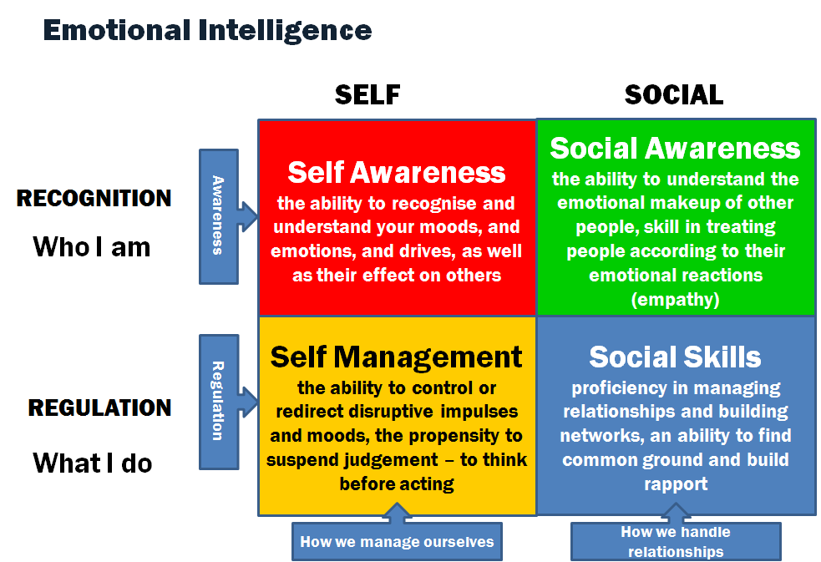
EQ has the following dimensions:

Slide 10
Environmental factors:
Include variables as economic,social,political and the like.
These are mainly external factors and will affect individual’s behaviour.
All work is performed within economic framework that both directly or indirectly affect org env.
Economic env is one of the main factor among them being the employment level,wage rates, economic outlook and technological change.
Employment opportunities strong influence on individual behaviour
Fewer job opportunities-job security issues.
Where job opportunities are several tendency of job hopping will increase.

Slide 11
The job that a person holds has significant influence on individual;s behaviour.(professor-salesperson)
Wages satisfy various individual needs.(food,shelter)
Money is a complex variable and its effect on behaviour varies tremendously.
Wages attracts people to certain org and determine their level of job satisfaction.
Technological changes considered as an economic factor bz of its
Potential effect upon job opportunities
It has the strongest impact on lower level jobs.
Automation mrobotics and other sophisticated production technologies can affect individuals at all levels.

Slide 12
Cultural Environment:
It is made up of institutions and other forces that affect society;s asic values,perceptions,work ethics,preferences and behaviours.
People grow up in different societies that shapes their basic beliefs,values and behaviours.
Culture varies from country to country-different behaviours.
Ethics and Social Responsibility:
Ethics- refers to a system of moral principles-a sense of right or wrong, goodness or badness of actions and the motives and the consequences of these actions.
As applied to business firm,it is the study of good and evil,right or wrong,just and unjust actions of business people.

Slide 13
Social responsibility also called CSR(corporate social responsibility)
Is the obligation of decision makers to take actions that protect and improve the welfare of the societyas a whole along with their own interests.
Refers to the commitment of business to contribute to sustainable economic dev,working with employees and families to improve their quality of life.
Political factors:
The stability of the govt can affect emp opportunities both in quantity and quality.
Unstable govt-difficult to provide job opportunities.
The quality of job also be affected by low capital investment.
The political ideology of a country affects individual beh primarly through the relative freedom available to its citizens.

Slide 14
Organizational Systems and Resources
Individual behaviour is influenced by physical facilities, org structure and design, leadership, work related behaviour and reward systems.
1)Physical Facilities: lighting, AC, décor, space provided for each emp, equipment have influence on emp performance.
2)Org structure and design: The way in which different groups and dept in an org are set up and the way in which reporting relationships and lines oc c/m are established among different positions in the org.
3)Leadership: An establishes org a system of leadership and supervision to provide direction,assistance,advice and coaching to individual employees.
Leader’s beh is a potential source of influence on an individual.

Slide 15
4)Reward systems: org must establish reward s/m to compensate their emp for good work done.
The beh and performance influenced by the reward s/m.
5)Work related behaviour: An individual’s beh is influenced by what stage he or she occupies in an org.
There are 5 stages of the individual’s stay in the org.
Joining the org
Exhibiting organizational citizenship
Remaining with the org
TYPES OF BEH IN ORG
Maintaining work attendance
Performing required tasks

Slide 16
1)Joining the org: An individual joins an org of his or her choice.
He or she needs the job just as the org needs the services of the individual(people need org and org need people)
In the induction stage new emp experiences excitement bz of the new assignment and expectations from it. And
Anxiety bz of the fear that the expectations might not be realised.
2)Remaining with the org:
The most challenging task of org is how to attract talent and retain it for the benefit of the firm.
Attract-by offering high remuneration packages.
Retaining is much more difficult for the org- as emp get exp-they try other companies-
For retaining the experienced (knowledge workers) emp managers has to adopt different interventions.

Slide 17
Emp may quit their job when they experience dissatisfaction.
The behaviour of a dissatisfied emp will be different from a job satisfied emp.
Less productivity from a dissatisfied emp.
A satisfied emp tend to exhibit commitment to work and show better productivity.
3)Maintaining work attendance :
Those who stay with the org are expected to report work as scheduled.
Some of them may take leave and their absences are caused by problems relating to health ,family responsibilities, vehicles breakdown, motivaton and job satisfaction in the workplace.
4)Performing required tasks :
People are hired to perform tasks.
Task performance refers to goal-directed activities that are under the individual’s control- need physical abilities and mental abilities-organisational effectiveness.

Slide 18
5)Exhibiting organisational citizenship:
Organisational effectiveness depends on more than satisfactory job performance.
It also relies on organisational citizenship.
Org behaviours extend beyond job-related tasks.
They include tolerating ambiguities, accepting occasional impositions, sharing resources and cooperating with fellow employees.

Slide 19
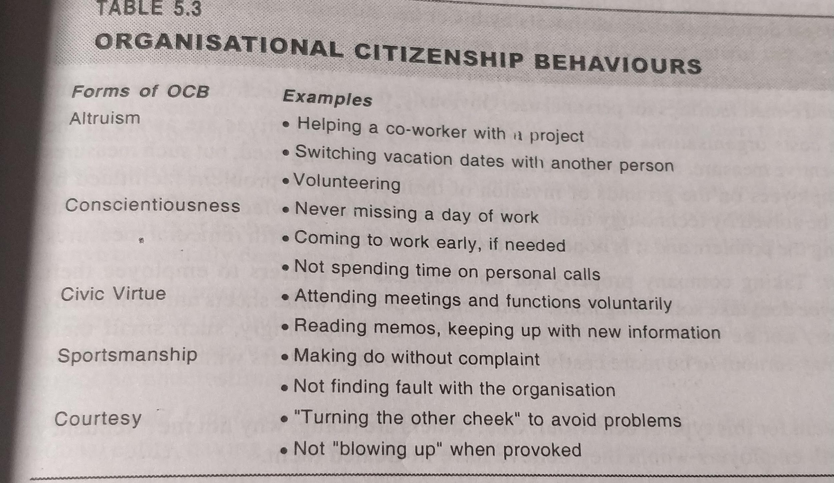

Slide 20
Psychological factors
Are individual’s mental char and attributes that can affect behaviour.
It is not always observable but their role in affecting individual beh is considerable.
Many Psychological factors are there,the more prominent among them are personality,perception,attitudes,values and learning.

